Slide 2
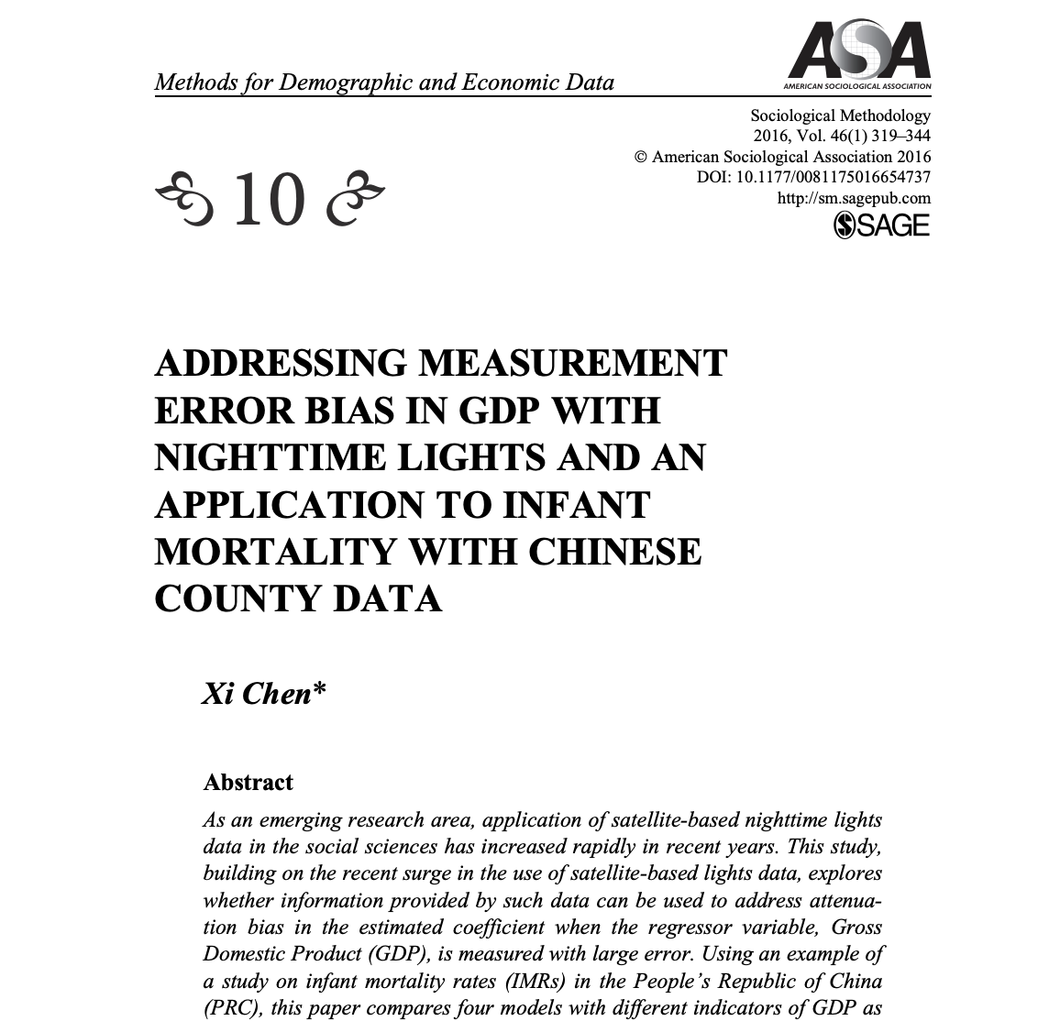
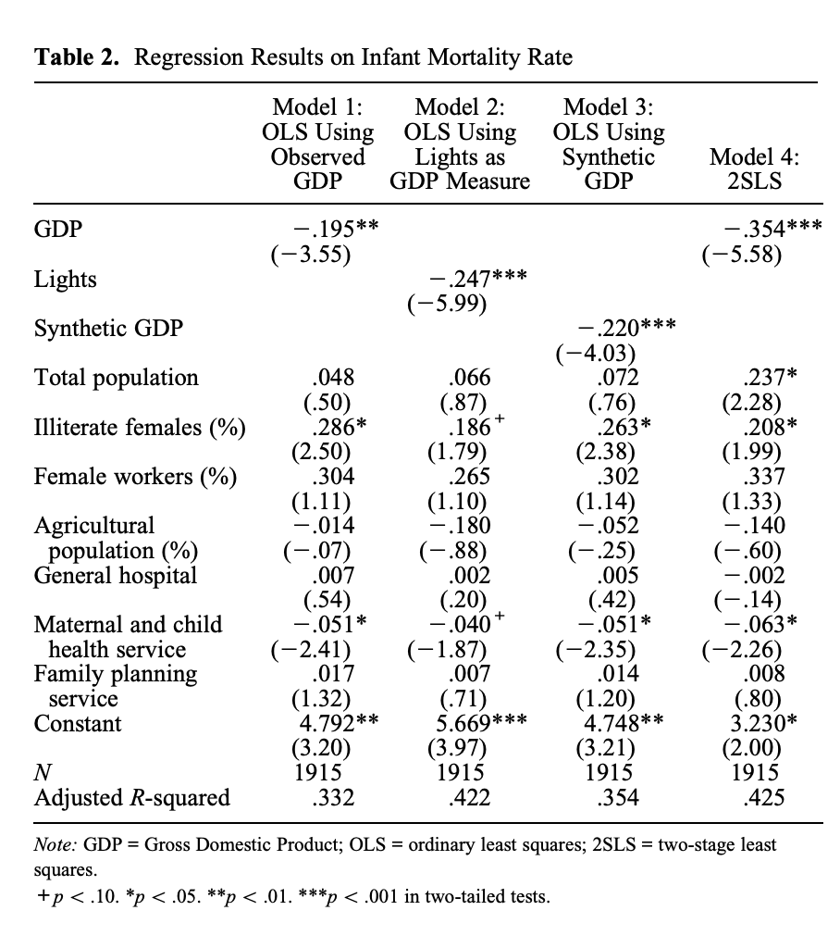
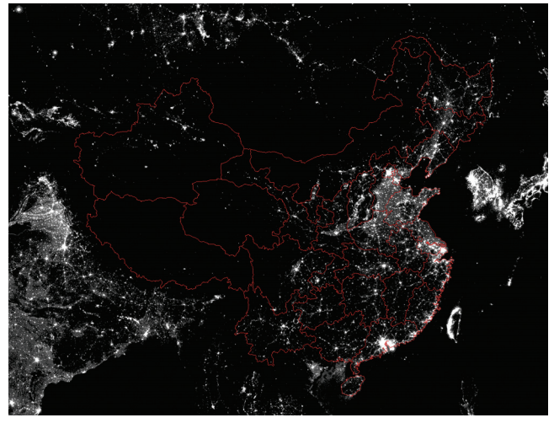
Case Study Four: Using Night Light to Predict IMR
Xi Chen (2016) ADDRESSING MEASUREMENT ERROR BIAS IN GDP WITH NIGHTTIME LIGHTS AND AN APPLICATION TO INFANT MORTALITY WITH CHINESE COUNTY DATA, Sage Publications, Vol. 46(1) 319–344, DOI: 10.1177/0081175016654737
Objectives: To predict Infant Mortality rate using satellite light data as an instrumental variable
Data Sources
China Data Online [Link]
Data
China GDP by County
2000 Average Night light from DMSP-15 satellite
Infant Mortality Rate(IMR)
China Census Data
GDP-Night lights synthetic variable

Slide 3
Case Study Four: Using Night Light to Predict IMR
Methodology
From the Infant Mortality dataset we calculate Infant Mortality Rate from the number of children that passed away at age 0 divided by the number of living children at age 0. Then, for the GDP/ Night Light synthetic variable we calculate it using the gdp and light data multiplied by weights(see below).
IMR = Children_{Deceased} ÷ Children_{Living}

Slide 4
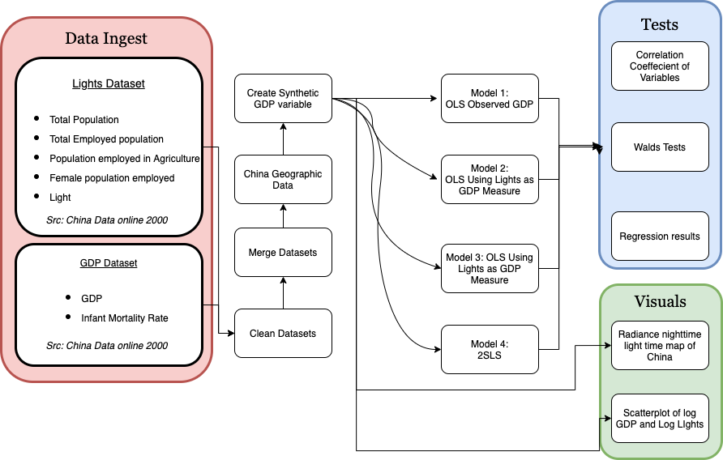
Case Study Four: Using Night Light to Predict IMR
Methodology

Slide 5
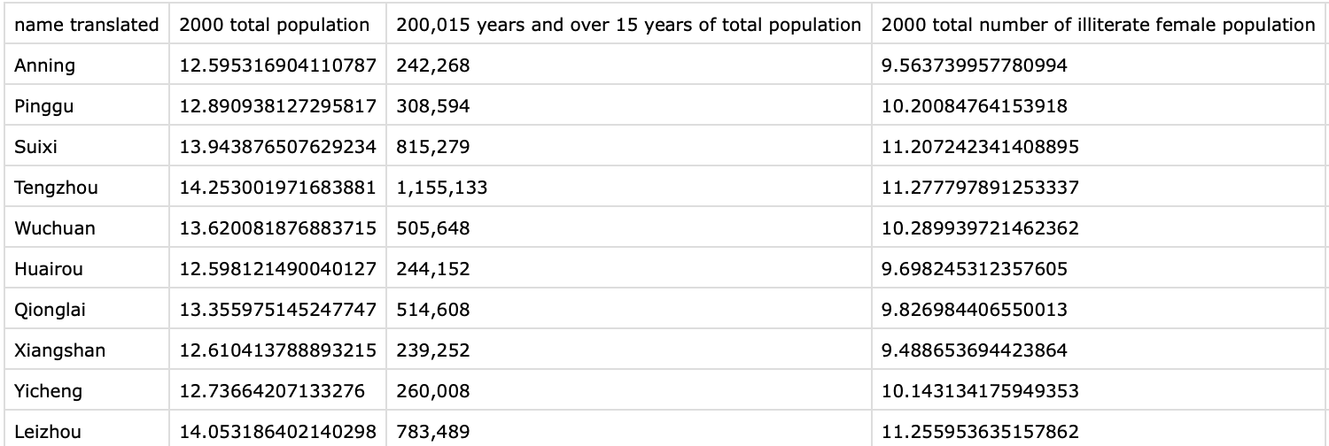
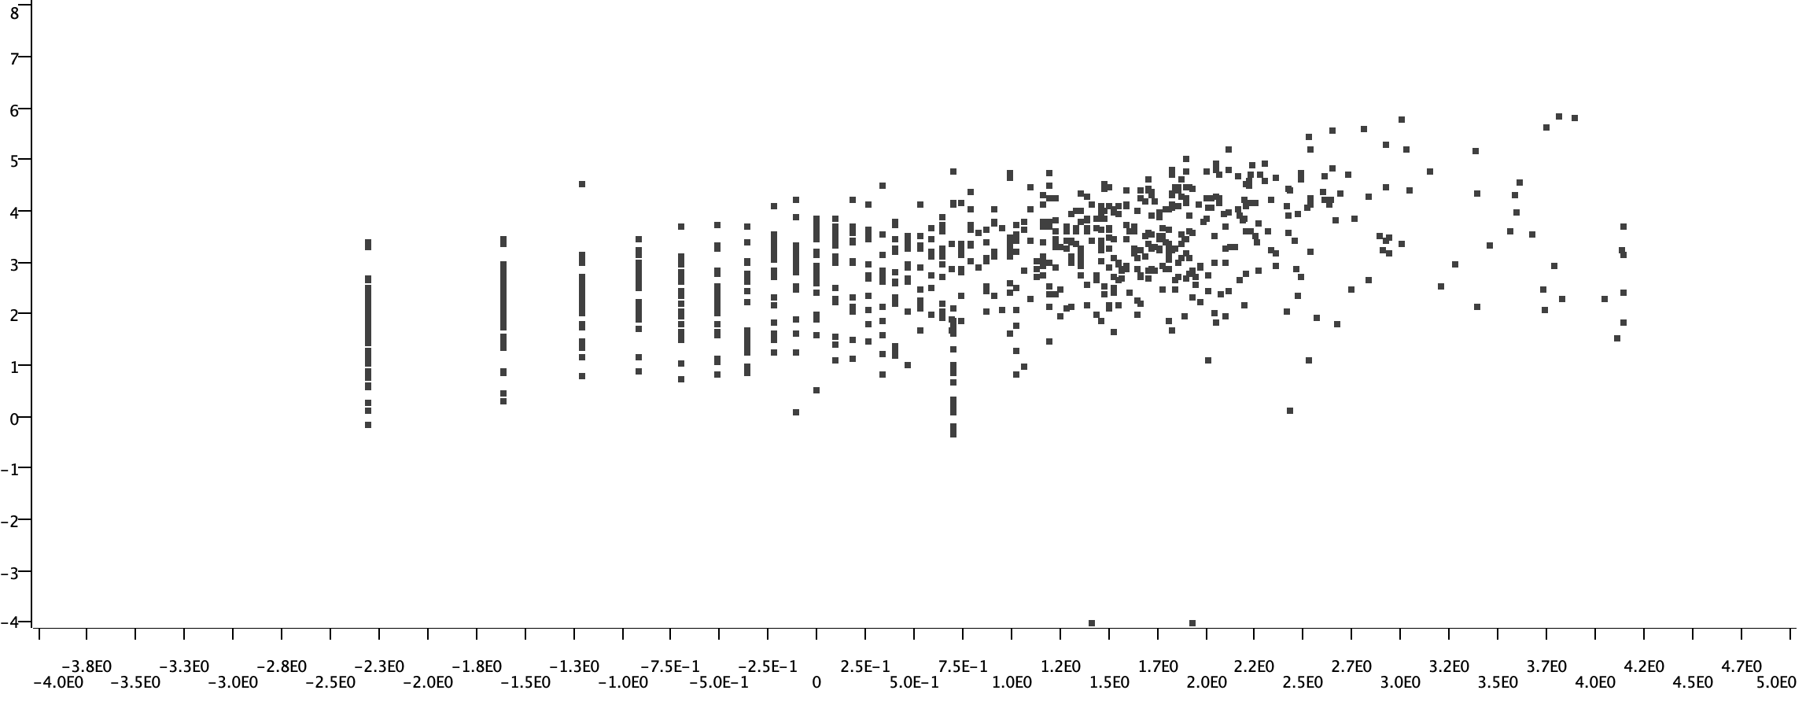
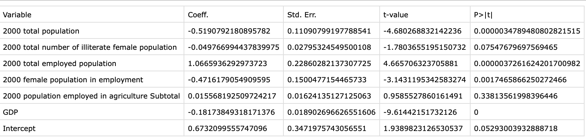
Case Study Four: Using Night Light to Predict IMR
Outputs from the Workflow
Final Dataset including IMR and GDP/Lights
(2000)
Scatterplot of GDP and lights
X-axis: Log(GDP)
Y-axis: Log(Lights)
Regression variable output

Slide 6
Online Demonstration

Slide 7
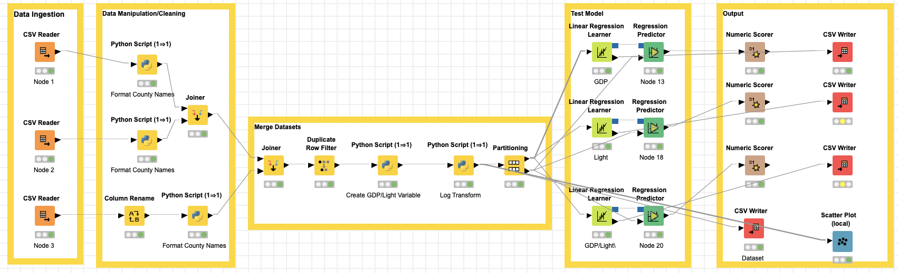
Case Study Four: Using Night Light to Predict IMR

Slide 8
Case Study Four: Using Night Light to Predict IMR
Steps for Running the Workflow
Step 1: Download data and unzip from https://github.com/kwonkh0424/KNIME_Project/tree/master/Flowcharts
Step 2: Download workflow from https://github.com/kwonkh0424/KNIME_Project/tree/master/Flowcharts
Step 3: Open KNIME from local PC or China Data Lab Cloud Platform (in building)
Step 4: Import KNIME workflow file (KNIME_GDP_Light.knwf)
Step 5: Configure “Input Data” for each table and figure
Step 6: Configure nodes in “exporting output” section on the local computer
Step 6: Click Run function from the top menu
Step 7: Display the outputs:
Gdp_Light_Dataset.csv
Model1.csv
Model2.csv
Model3.csv

